Slide 1
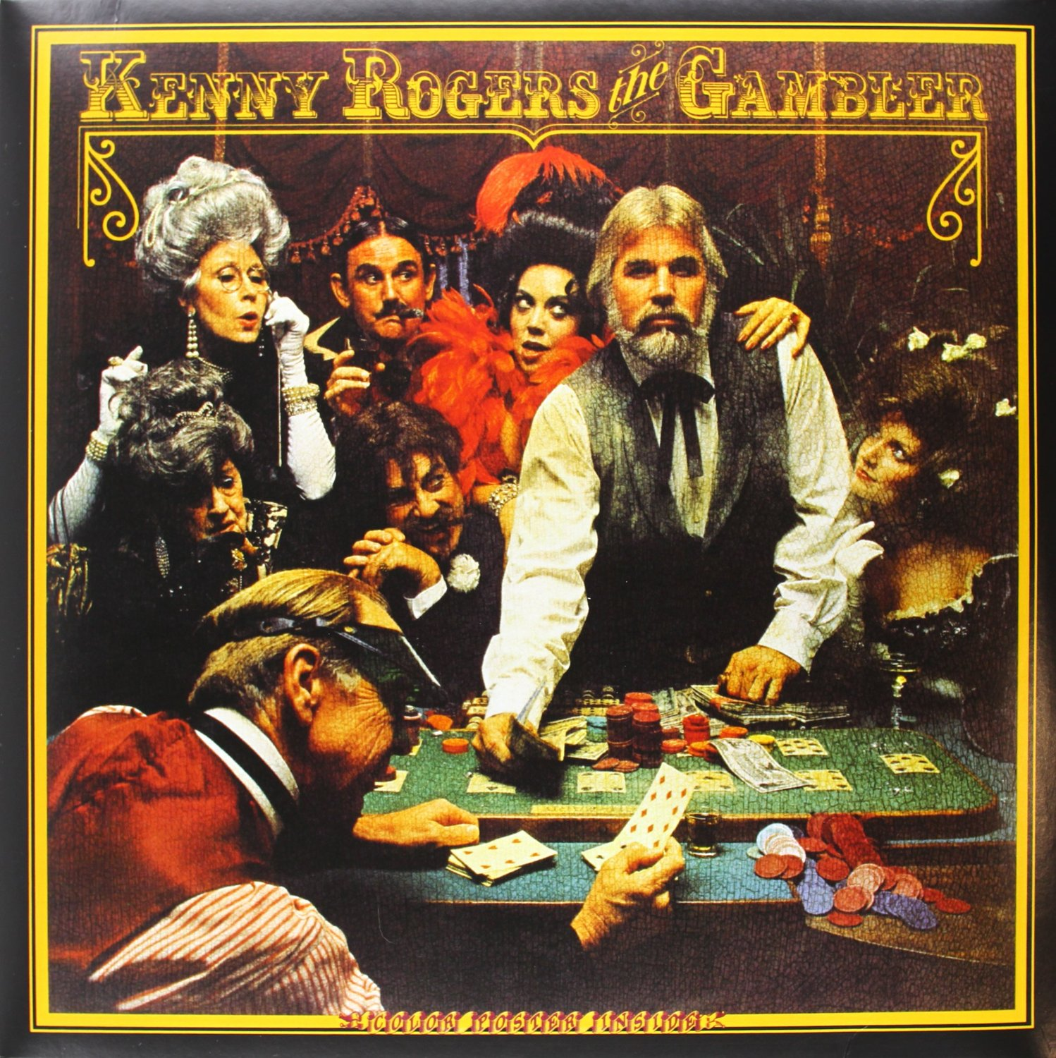

Slide 2
The Nucleus Accumbens The Know When to Hold Them, Know When to Fold Them Center
By James Robertson

Slide 3
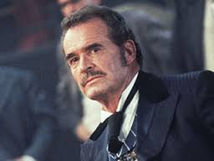
Let’s Use Our NAc in an RPG!
Brenna: Annabelle Bransford
Poker Skill: Middlin’
Style: Aggressive
Notes: Something to Prove
James: Brett Maverick
Poker Skill: High
Style: Risk Taker
Notes: Impulsive
Clarissa: Level One Wood Elf
Poker Skill: None (Game not found in Forests of Lothlorien)
Style: Very Confused
Notes: +2 Magelight Bracers
(handy in battle, useless in poker)
Cliff: Marshall Zane Cooper
Poker Skill: High
Style: Seasoned Gambler
Notes: Cautious

Slide 4
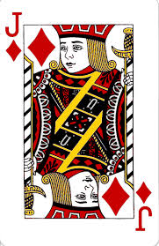
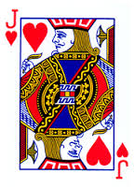
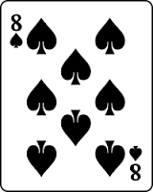
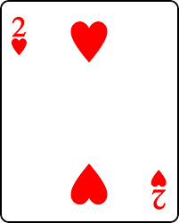
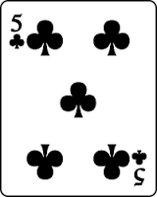
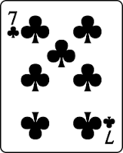
James’ Hold ‘Em Hand Start of the Game
Option Two
Option One
James: $250
Cliff: $250
Brenna: $250
Clarissa: $250
Option Three
First Bet of Game

Slide 5
Cliff’s Hold ‘Em Hand Middle of the Game
Option Two
Option One
James: $400
Cliff: $200
Brenna: $150
Clarissa: $250
Option Three
Last Bet: Check from James

Slide 6
Brenna’s Hold ‘Em Hand Late Game
Option Two
Option One
Cliff: $400
Brenna: $150
Clarissa: $450
Option Three
Last Bet: $150 from Cliff

Slide 7
Clarissa’s Hold ‘Em Hand End of the Game
Option Two
Option One
Cliff: $500
Clarissa: $500
Option Three
Last Bet: Cliff goes All In!

Slide 8
Causality?
Why did you hold them or fold them when you did?
Risk (Money at Stake) Reward (Money to be won)
Experience
Social Mores
Extraneous Factors
Personality
Hold ‘Em
Fold ‘Em

Slide 9
What we know so far:
Cliff: NAc integrates information to direct appropriate responses
When to hold them/fold them
Tim : DA-MSN pathways in the NAc influence behavioral outcomes
Modulated by GABAergic circuitry for susceptible (D2) or resilient (D1) behavior (Poker play style)
Clarissa: VTA-DA inhibition ➔ downregulation of NAc DA
D2R is important for aversive stimuli (Are you losing?)

Slide 10
What we know so far:
Shaydie: CRF produces positive/negative affect depending on prior stressful experience
How did that last hand go for you?
Deb: VTA → NAc DA circuitry is directly responsible for reinforcement
Are you winning? Do you want to keep winning?
Matt and Bikash: NAc Core activation relates to reduced pain, increased craving
How badly do you want to win?

Slide 11
Causality?
Why did you hold them or fold them when you did?
Risk (Money at Stake) Reward (Money to be won)
DA signaling
CRF signaling
Core vs. Shell Activation
Level of Reinforcement
Hold ‘Em
Fold ‘Em

Slide 12
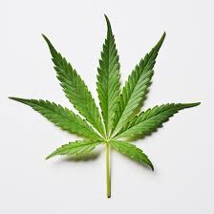
What sets the mixing board?
It’s Endocannabinoids

Slide 13
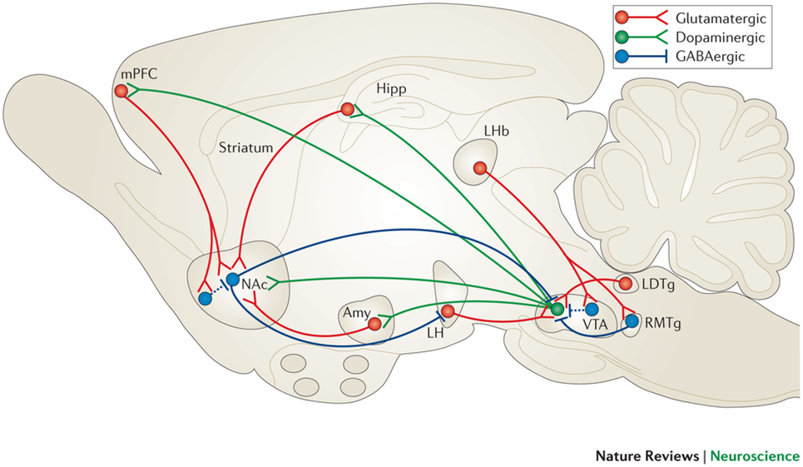
Oleson 2012
NAc DA increases in response to reward
Arise from high freq. firing of VTA DA neurons
Which also sprinkle-out some endocannabinoids
So, do endocannabinoids regulate behavior by modulating DA signaling?

Slide 14
Yes, Probably
CB1 antagonist Rimonobant DA in Nac
Also Reduced Drug Seeking Behavior
Also Reduced Cue Induced DA response
But would increasing upstream eCB signalling (VTA) increase downstream DA signalling (NAc)?

Slide 15
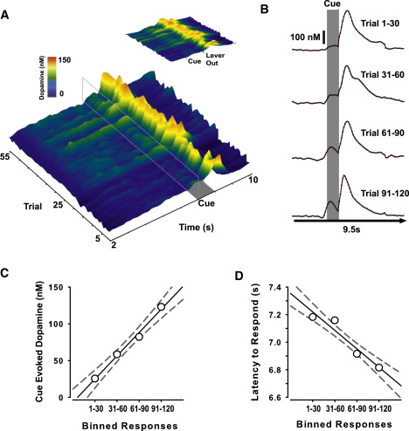
Oleson Fig 1
Cue evoked DA Concentrations
Pavlovian Associations strengthen response, reward seeking

Slide 16
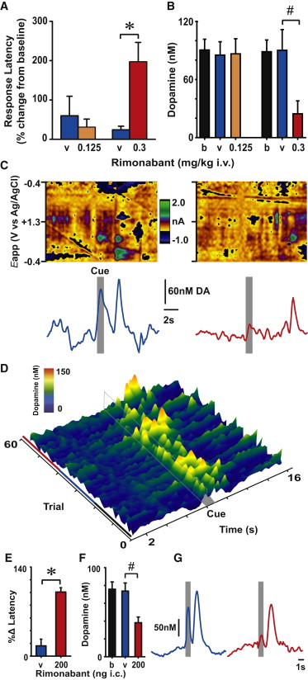
Oleson Fig 2
Disrupting eCb signaling decreases Cue-Evoked DA during Reward Seeking

Slide 17
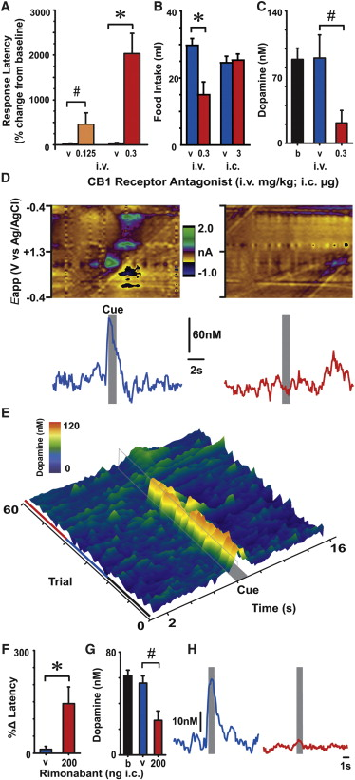
Oleson Fig. 3
Disrupting ECB Signaling Decreases Cue-Evoked Dopamine Neurotransmission during Appetitive Food Seeking
Appetitive NOT consummatory

Slide 18
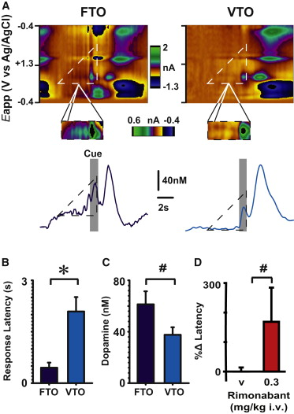
Oleson Fig 4
Disrupting eCb Signaling affects the salience of cues predicting rewards; not their timing

Slide 19
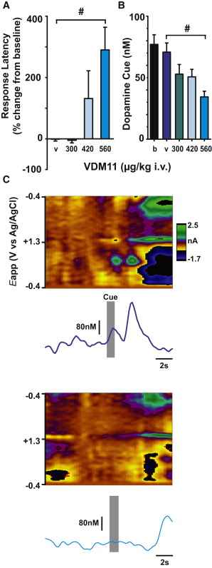
Oleson Fig 5
The Putative Endocannabinoid Uptake Inhibitor VDM11 Decreases Dopamine Mechanisms of Reward Seeking in a Manner that Is Consistent with Indirect Cb₁ Receptor Antagonism

Slide 20
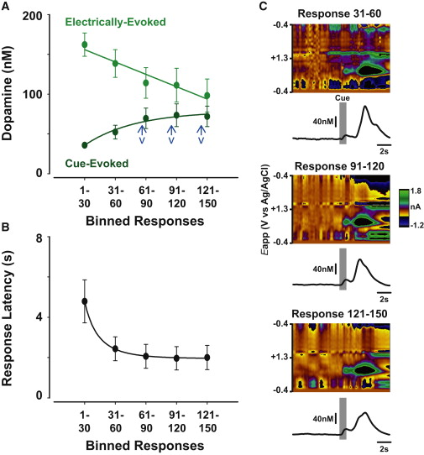
Oleson Fig 6
Electrically Evoked, but Not Cue-Evoked, Dopamine Concentrations Are Partially Depleted during ICSS Sessions

Slide 21
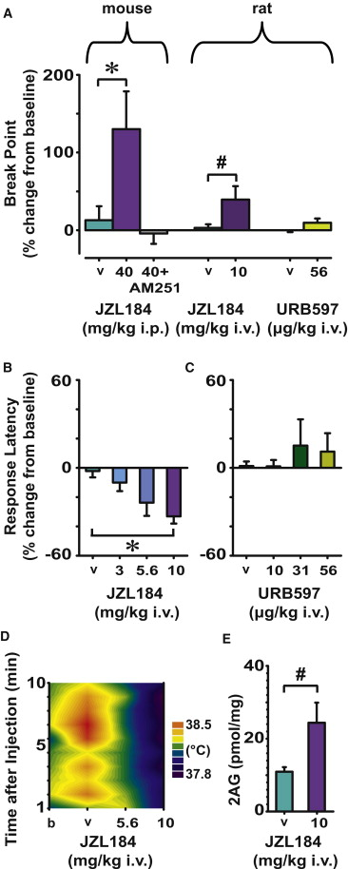
Oleson Fig 7
The Endocannabinoid 2AG, but Not Anandamide, Facilitates Reward Seeking

Slide 22
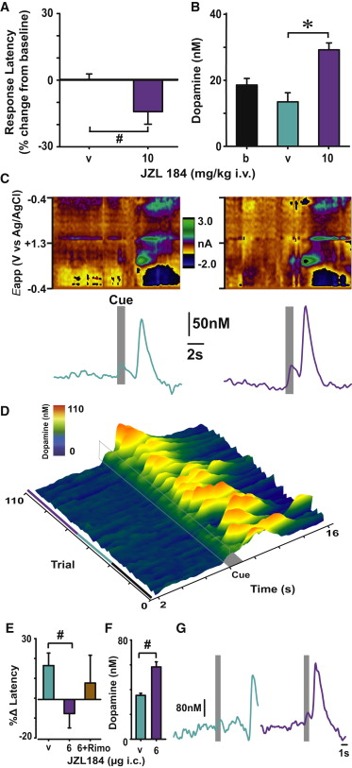
Oleson Fig 8
The Endocannabinoid 2AG Facilitates Dopaminergic Mechanisms of Reward Seeking

Slide 23
eCb and DA
Disrupt eCb signalling?
↓ Cue Evoked DA release
↓ Reward seeking
2-AG ➔ ethologically relevant patterns of DA release
Direct reward-motivated behavior

Slide 24
Winters – CB1 Expressing Neurons in the NAc
Cb₁ receptors identified in the NAc
Sparse
Inhibiting Cb₁-R in NAc ➔ reduced cocaine reward response
How does Cb₁-R exert its effect in the Nucleus Accumbens?

Slide 25
Optogenetics
Flourescent Protein td-Tomato
Expressed under control of endogenous Cb₁ promoter
Found exclusively on Fast Spiking Interneurons
FSIs
Exert inhibitory control on nearby MSNs

Slide 26
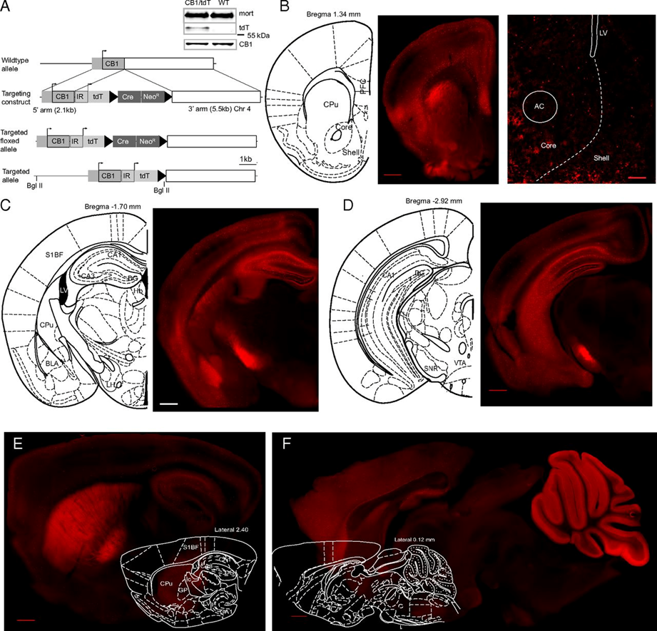
Winters Fig 1
Genetic labeling of Cb₁.
Expression of Cb₁ was similar between WT and Cb₁/tdT transgenic mice

Slide 27
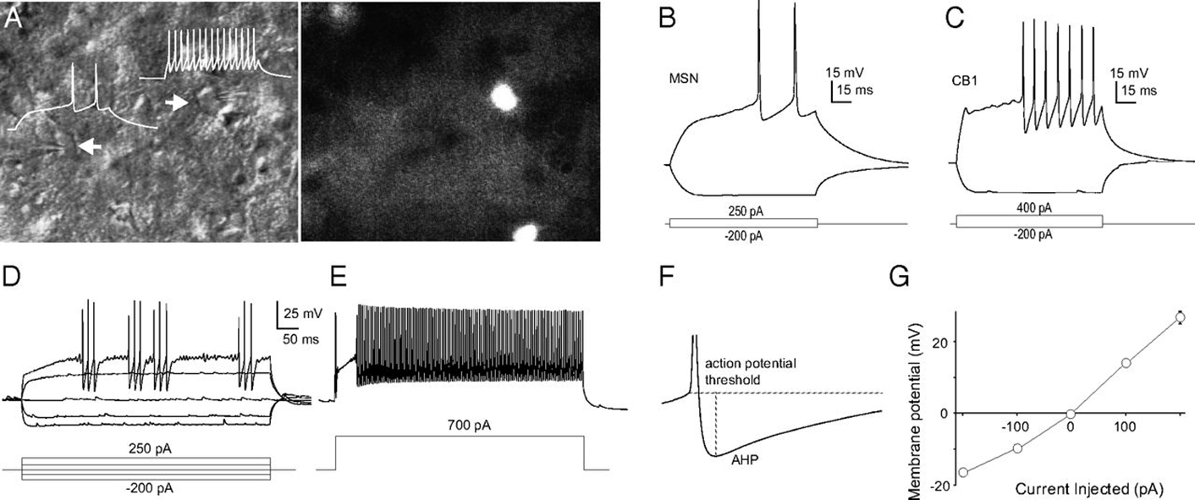
Winters Fig 2
Cb₁-expressing neurons in the NAc are FSIs.

Slide 28
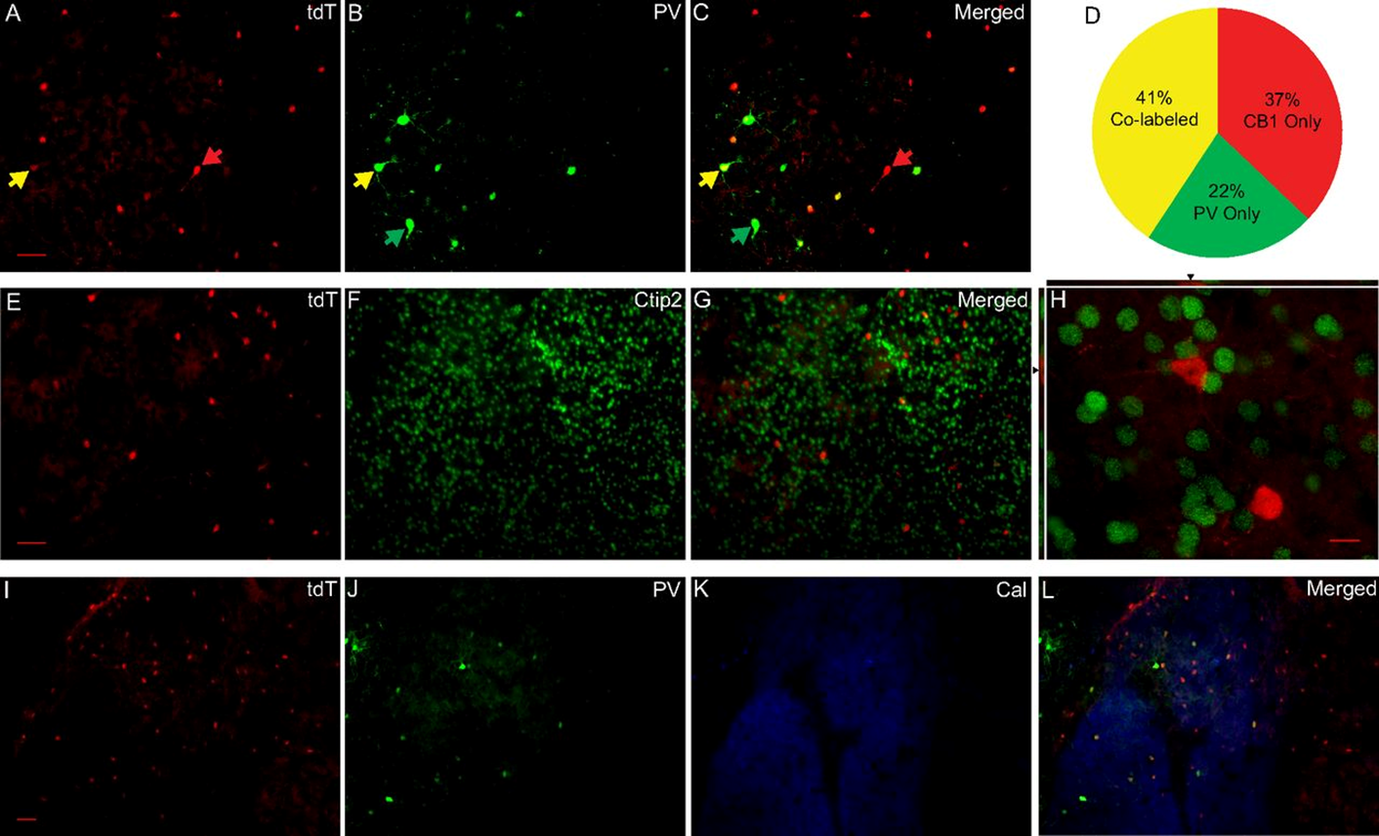
Winters Fig 3
Biochemical properties of Cb₁-expressing neurons in the NAc.

Slide 29
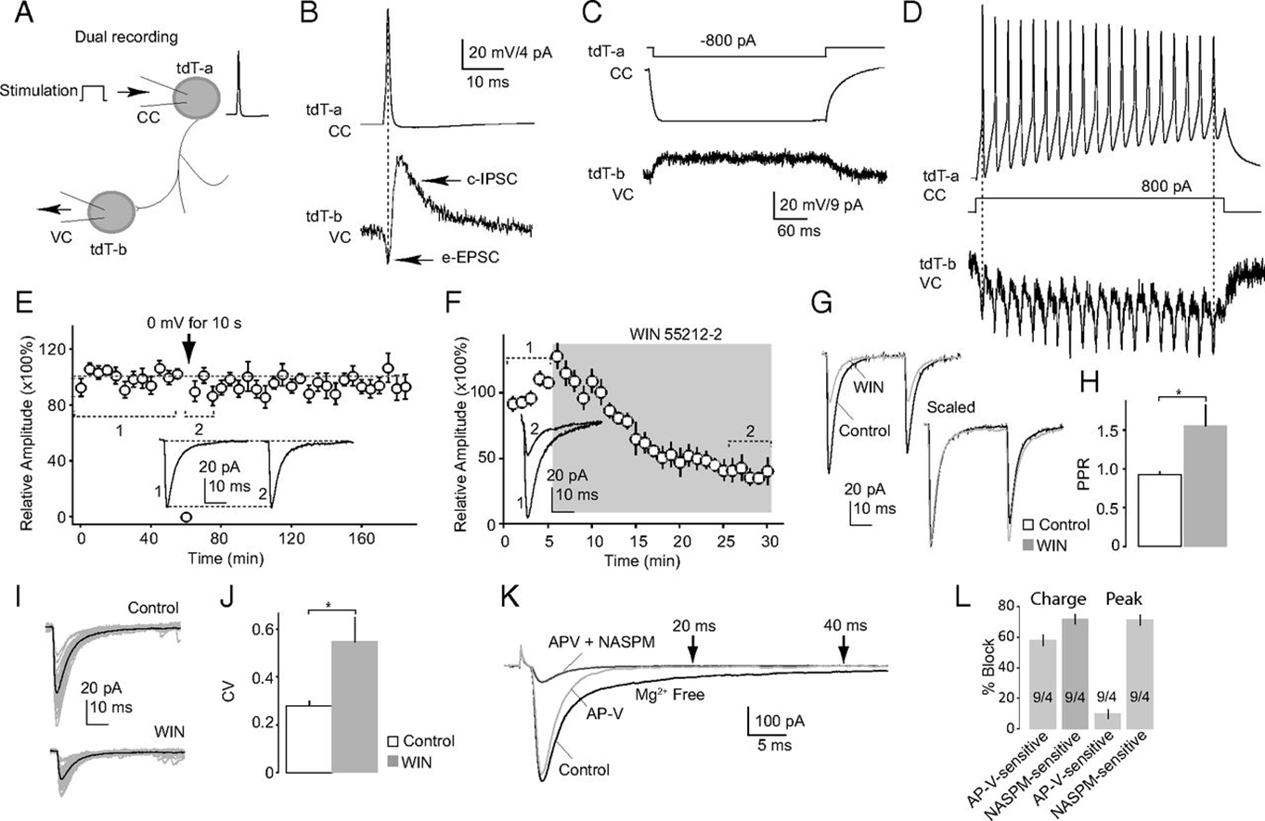
Winters Fig 4
Single AP in tdT-a elicited a simultaneous inward current (EPSC) in tdT-b, contingent
Events suggest an electrical coupling between the two recorded neurons.
IPSCs from inhibitory synapses between two tdT-positive FSIs were sensitive to activation of Cb₁; perfusion of the Cb₁ -selective agonist WIN decreased the amplitude of IPSCs.

Slide 30
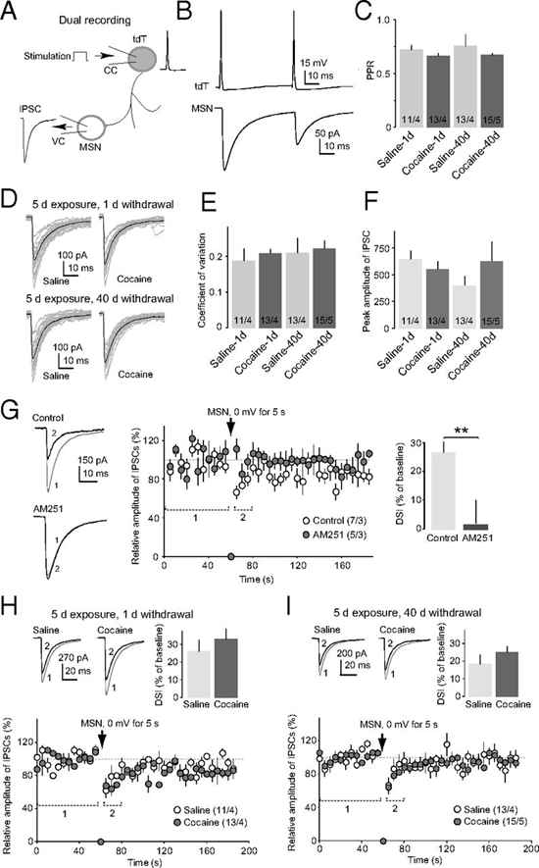
Winters Fig 5
Unitary synaptic transmission from Cb₁-expressing FSIs to MSNs in the NAc.
Example traces and summarized results show intact DSI of uIPSCs at tdT-to-MSN synapses in animals on withdrawal day 1 (H) and day 40 (I) after exposure to cocaine. **P < 0.01.

Slide 31
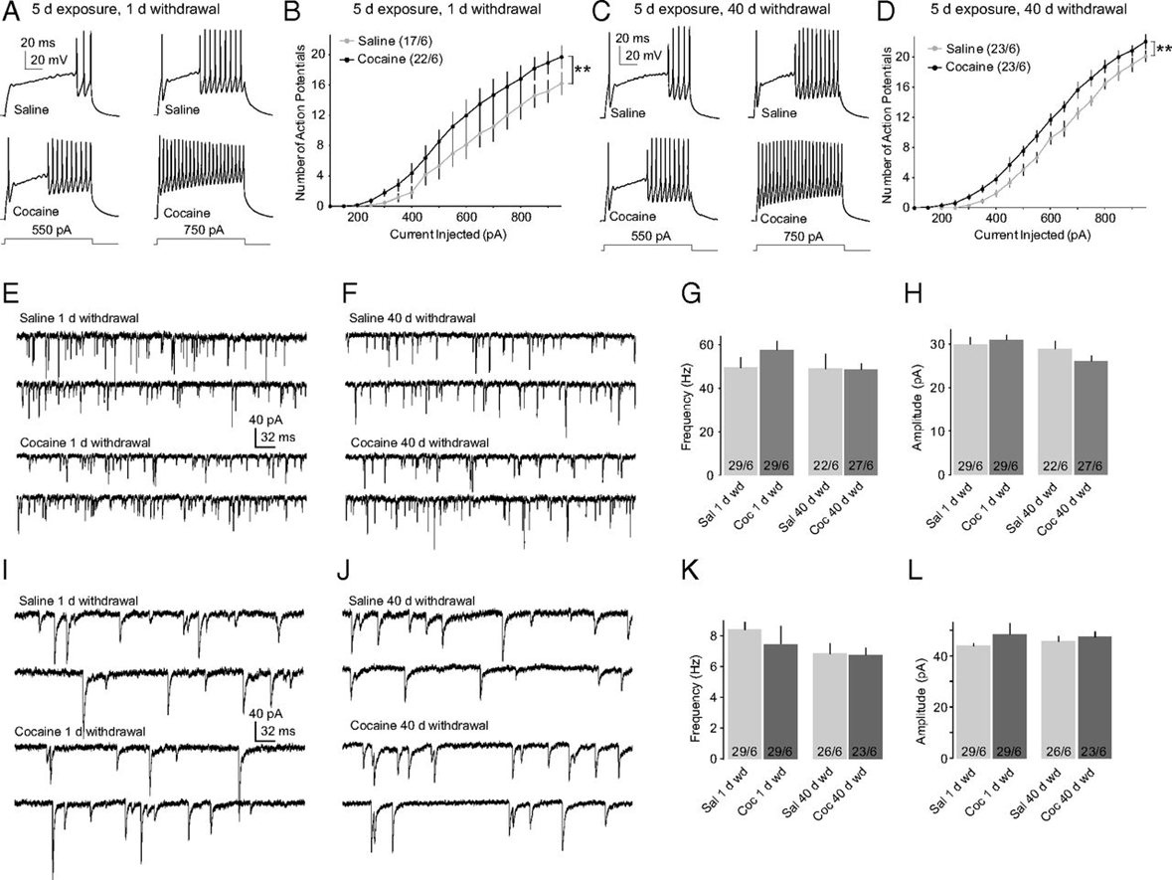
Winters Fig 6
Exposure to cocaine increased the intrinsic membrane excitability of Cb₁-expressing FSIs in the NAc

Slide 32
Winter’s Take Home Messages
Cb₁ expressing neurons are Fast Spiking Interneurons
FSI – electrically coupled
Like some sort of network (synchronicity)
FSI – GABAergic projection to MSNs

Slide 33
Winter’s Take Home Messages
FSI exerts strong inhibitory control on MSNs
Cocaine increases this influence
Then during withdrawal, excited FSIs dampen response of MSNs, NAc during cocaine withdrawal

Slide 34
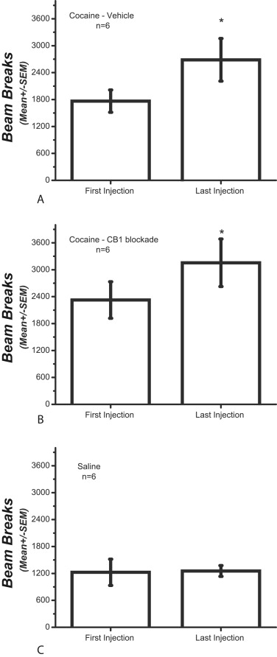
Hernandez Fig 1
Figure 1. Locomotor activity for the different groups in the reversal experiment. When the activity between the firstcocaine injection and the last cocaine injection are contrasted, repeated cocaine administration produces an increase in locomotor activity (p < .05) in the groups that received AM251 (A) or vehicle (B) before the delay discounting task. In contrast, the locomotor activity of rats injected with saline (C) remained unaltered (p > .05). Cb₁, cannabinoid type 1 receptor.

Slide 35
Hernandez 2014
How does the Cb₁ modulation of DA signalling effect relevant behavior?
Impulsivity and the Delay Discounting Task
Nose Pokes and Rewards

Slide 36
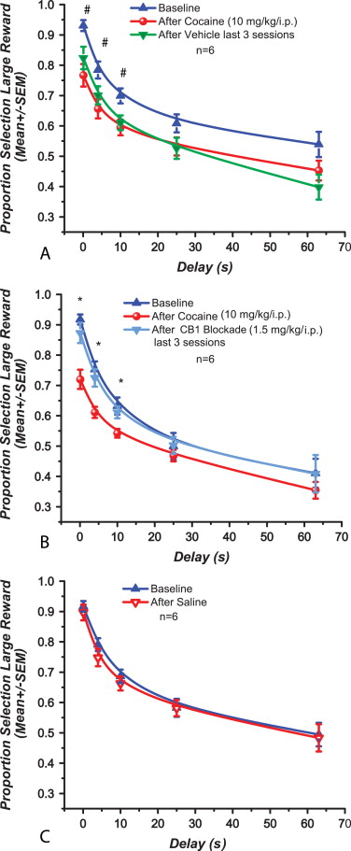
Hernandez Fig 2
Cocaine pre-exposure (red circles) consistently reduces the selection of the delayed large reward. Vehicle administration (green triangles) before the delay discounting task does not have any effect on the cocaine-induced decrease. Both performances are statistically similar
Such reduction is reversed by AM251 administration (light blue triangles) before the delay discounting task.

Slide 37
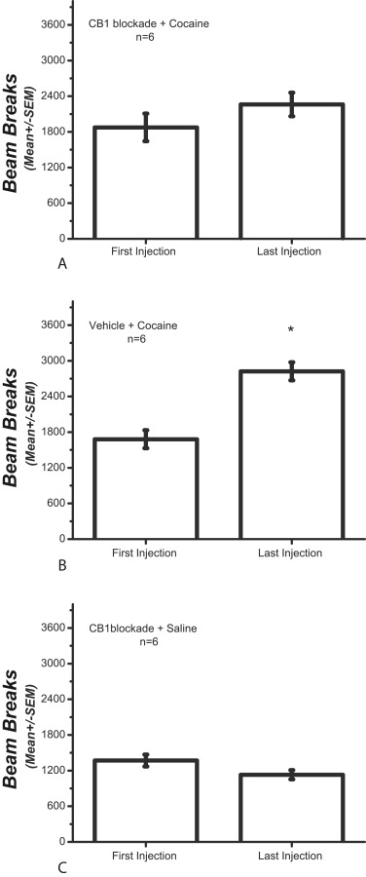
Hernandez Fig 3
There is an increase in the average locomotor counts between the first and the last cocaine injection in the cannabinoid type 1 (Cb₁) blockade + cocaine group

Slide 38
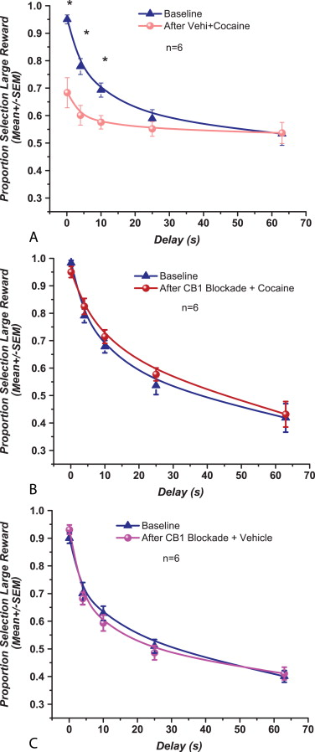
Hernandez Fig 4
Figure 4. Rimonabant (1.5 mg/kg/intraperitoneal) prevents the effects of cocaine pre-exposure on choice of the delayed reward.

Slide 39
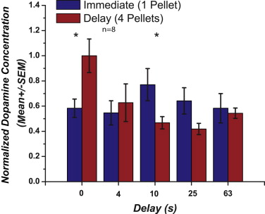
Hernandez Fig 5
Phasic dopamine
release for both reward magnitudes at different delays.

Slide 40
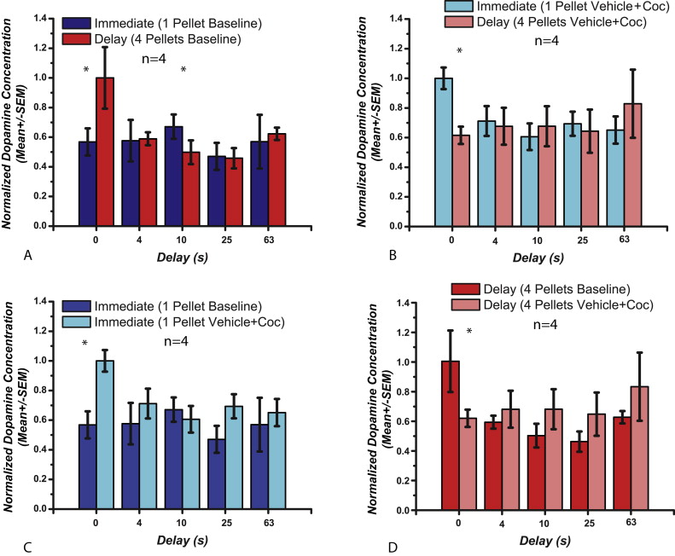
Hernandez Fig 7
Bar graphs of pooled dopamine (DA) release to reward delivery at different delays for vehicle-treated rats

Slide 41
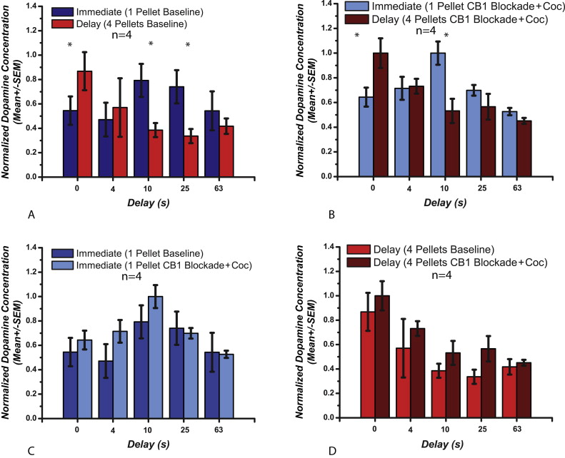
Hernandez Fig 9
Hernandez Fig 9

Slide 42
Causality?
Why did you hold them or fold them when you did?
Risk (Money at Stake) Reward (Money to be won)
DA signaling
CRF signaling
Core vs. Shell Activation
Level of Reinforcement
Hold ‘Em
Fold ‘Em

